Slide 1

DevOpsCodeSmith
DevOpsCodeSmith is a groundbreaking AI-powered coding solution that combines intelligent code generation, multilingual text processing, and seamless CI/CD integration. This innovative platform empowers developers to write code more efficiently and effectively.
Presented By
Shaik sameer Hussain : 227R1A05Q7

Slide 2
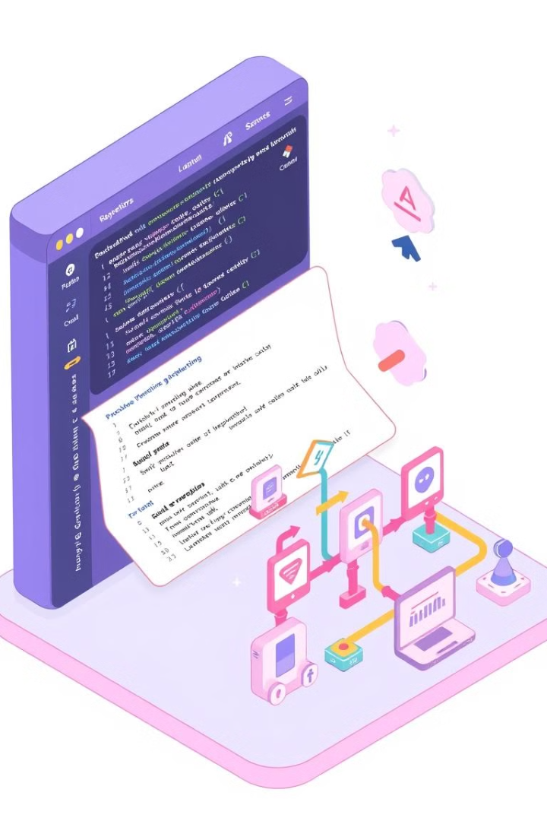
Project Overview
1
Automated Code Generation
2
Multilingual Support
Process and understand user input in various languages, facilitating global collaboration.
Generate code in multiple programming languages based on natural language prompts.
3
Streamlined Development
Integrate seamlessly with CI/CD workflows for faster deployments and improved efficiency.

Slide 3
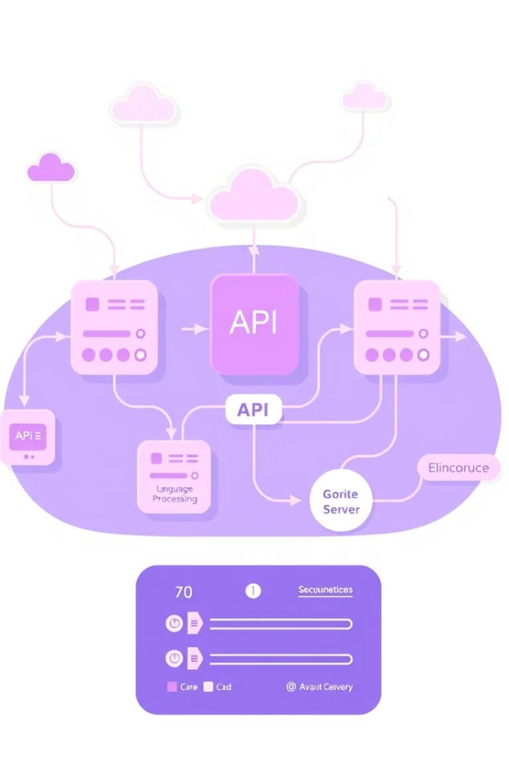




System Architecture
Server
The server acts as the central hub for processing requests and managing the application.
APIs
Well-defined APIs facilitate communication between the front-end user interface and the back-end server logic.
Language Processing
Natural language processing (NLP) engines analyze user input and translate it into code based on the selected language.
Code Output
The output module generates the corresponding code in the user-selected programming language, ready for integration into projects.

Slide 4





Key Features
CI/CD Integration
GitHub Version Control
Automated continuous integration and continuous delivery (CI/CD) ensure smooth code deployment and efficient testing workflows.
Integrated version control using GitHub provides a centralized repository for code management and collaboration.
Docker Containerization
Render Deployment
Docker containerization provides a lightweight and portable environment for code execution and deployment across various platforms.
Render streamlines the deployment process by providing a serverless platform for hosting and scaling applications.

Slide 5
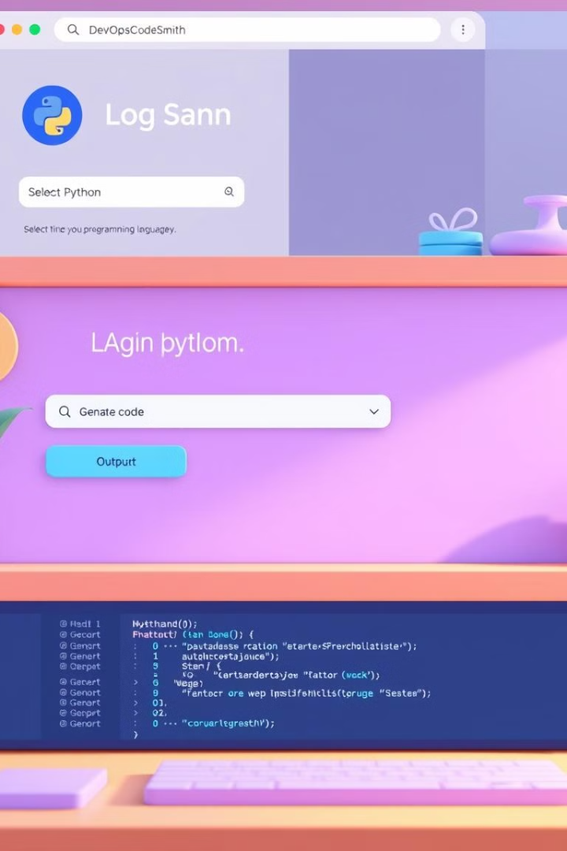
User Workflow
1
Login
Users authenticate to access the platform, ensuring secure access to code generation features.
2
Language Selection
Users choose the desired programming language, tailoring the code generation process to their specific needs.
3
Code Generation
Users input their problem statements in natural language, and the tool generates code based on their specifications.
4
Code Output
The platform displays the generated code, allowing users to review and integrate it into their projects.

Slide 6
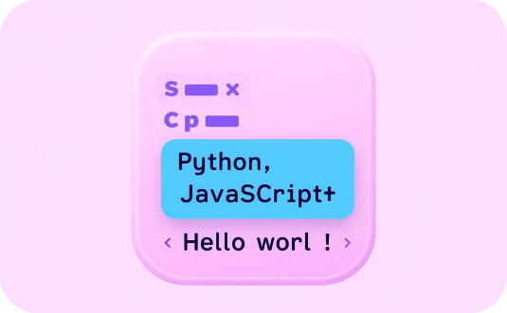


Key Features
DevOpsCodeSmith offers a comprehensive set of features.
Language Support
CI/CD Integration
User-Friendly Interface
Generate code in multiple languages.
Seamless integration with DevOps pipelines.
Easy to use for developers of all levels.

Slide 7





CI/CD Integration with GitHub
GitHub Workflow
Automates code builds, testing, and deployment using GitHub Actions.
Version Control
Manages code versions and tracks changes efficiently through GitHub repositories.
Automated Deployment
Seamlessly deploys code to cloud platforms using pre-defined workflows.

Slide 8

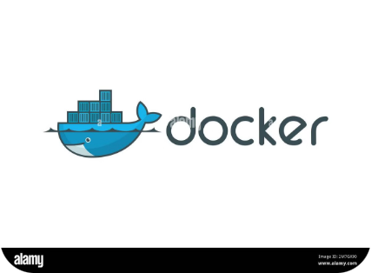



Docker and Render Deployments
Docker Containerization
Render Deployment
Live Application
Packages the application and its dependencies into a portable Docker image.
Deploy the Docker image to Render, a cloud platform for web applications.
The application is accessible through a unique URL provided by Render.

Slide 9
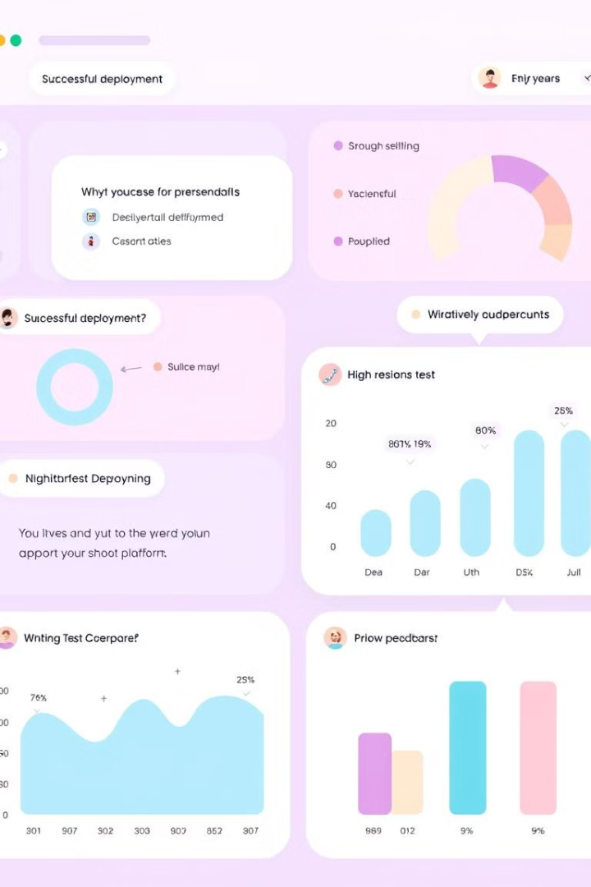
Testing and Results
Test Case
Result
Code Generation Accuracy
98% success rate
Deployment Reliability
100% successful deployments
User Satisfaction
Positive feedback on code quality and ease of use

Slide 10
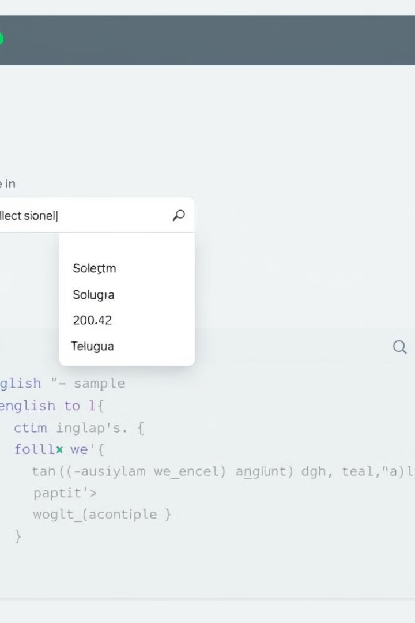
User Interface and Functionality
Language
Code Example
English
print("Hello, world!")
Telugu
print("నమస్తే, ప్రపంచం!")
Hindi
print("नमस्ते, दुनिया!")
Urdu
print("اَسَلَامُ عَلَيْكُمْ، دُنْيَا!")

Slide 11
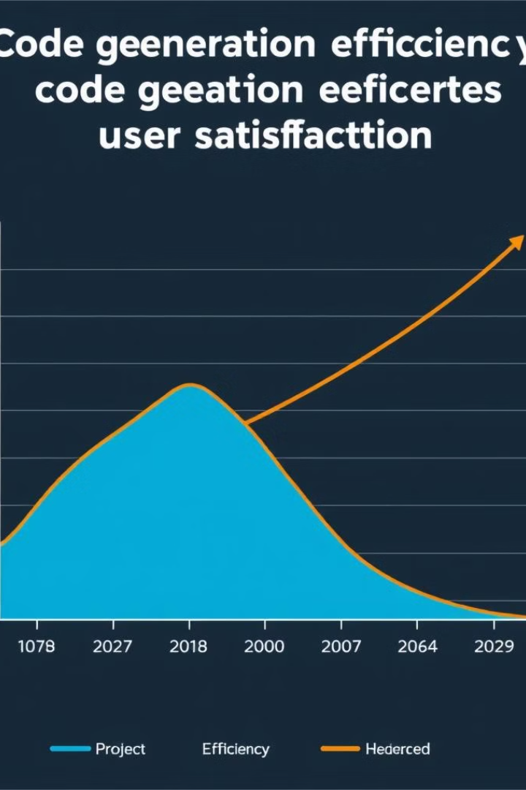
Results and Impact
Successful Deployments
User Satisfaction
Users report increased productivity and improved code quality due to the tool's capabilities.
DevOpsCodeSmith has been successfully deployed in numerous projects, achieving significant outcomes.
Efficiency Gains
The AI-powered code generation and multilingual support streamline development processes.

Slide 12
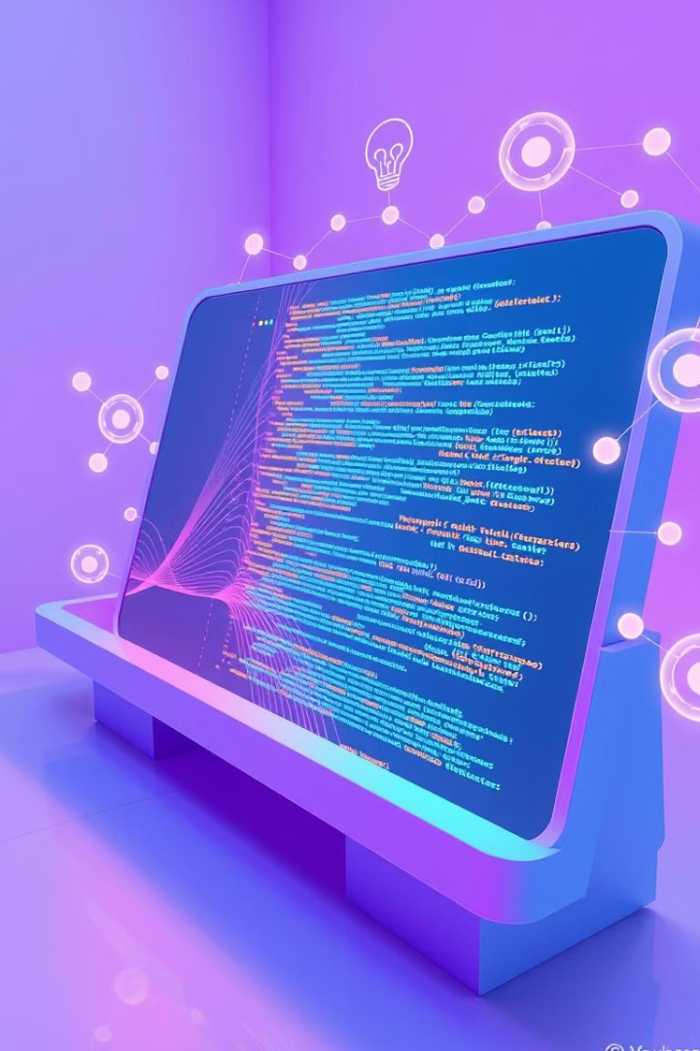
Future Directions
Continuously enhancing DevOpsCodeSmith with new features.
1
AI-Powered Code Generation
2
Expanded Language Support
Leverage AI for more intelligent code generation.
Support a wider range of programming languages.
3
Cloud Integration
Seamless integration with cloud platforms.

Slide 13
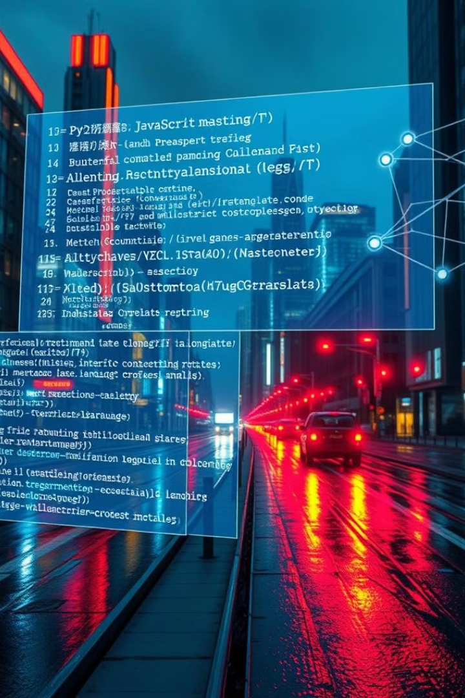
Future Expansions
1
Enhanced AI Capabilities
Improve the AI model to generate more complex and sophisticated code.
2
Additional Language Support
Expand the tool's support to encompass a wider range of languages.
3
Integration with Other Tools
Integrate seamlessly with popular IDEs and development platforms.

Slide 14




Benefits of DevOpsCodeSmith
Enhances development efficiency and productivity.
Faster Development
Streamlines code creation and deployment.
Improved Code Quality
Reduces errors and inconsistencies.
Enhanced Collaboration
Improves communication and teamwork.

Slide 15

Conclusion
DevOpsCodeSmith represents a significant advancement in AI-assisted coding, empowering developers to build applications efficiently, while promoting global collaboration and fostering innovation in software development. The project's impact extends beyond individual development teams, impacting the entire software engineering landscape.

